Slide 1
Angular CLI
Generating a New Angular Application
Lecture 3
By James(Jin) Wang
09/28/2019

Slide 2
Outline
Generating an app
Learning the flags
Configuring and customizing the CLI
Checking and fixing the code

Slide 3
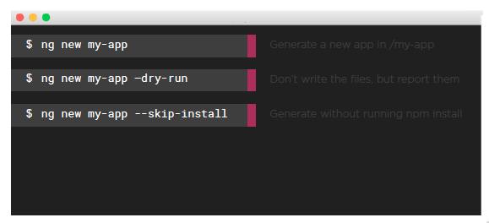
Generating a New Application
  Generating a New Application:

Slide 4
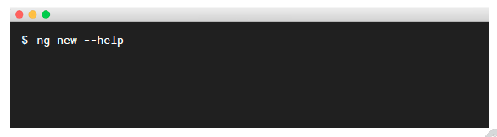
Generating a New Application
  Getting Help:
  Add the --help flag
  Reports the many options and their defaults

Slide 5
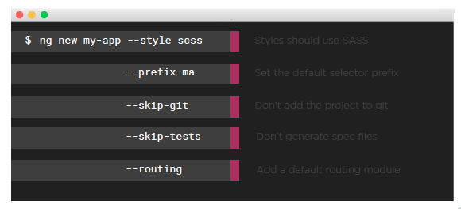
Learning the flags
  Common App Generation Flags:

Slide 6
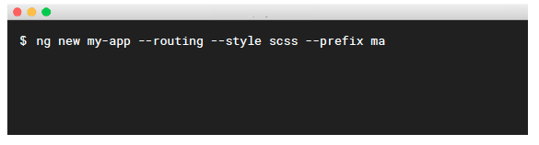
Learning the flags
  Many flags can be combined:
  Ideal for settings that should exist throughout the app
  Some flags change the configuration in angular.json

Slide 7
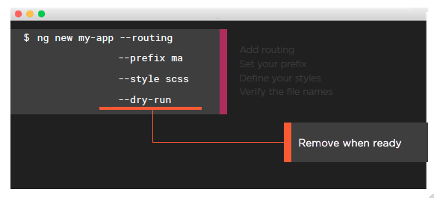
Learning the flags
  Tip:

Slide 8
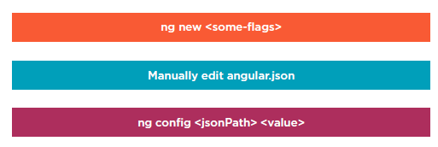
Configuring the Angular CLI
  Options to Configure the CLI:

Slide 9
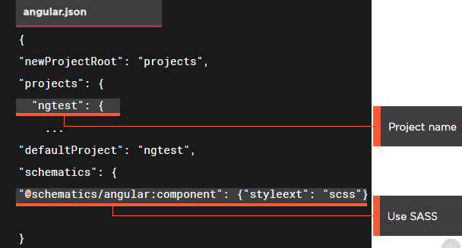
Configuring the Angular CLI

Slide 10
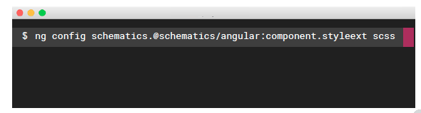
Configuring the Angular CLI
  Setting the Angular CLI’s Configuration:
  Use ng config
  Indicate the json path
  The --global flag sets your global angular.json file

Slide 11
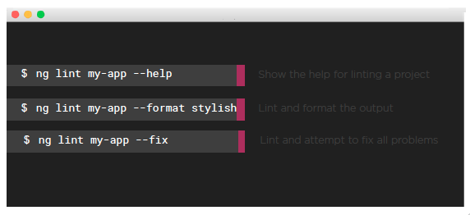
Checking and fixing the code
  Linting:

Slide 12
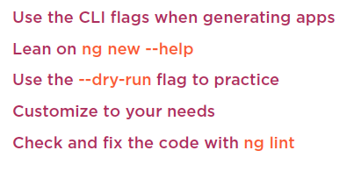
Summary

